Slide 1
Part II Bioenergetics and Metabolism

Slide 2
What is metabolism
The entire set of enzyme-catalyzed transformations of organic molecules in living cells
The sum of catabolism and anabolism
Provides fascinating and revealing insights into life, with countless applications in medicine, agriculture and biotechnology

Slide 3
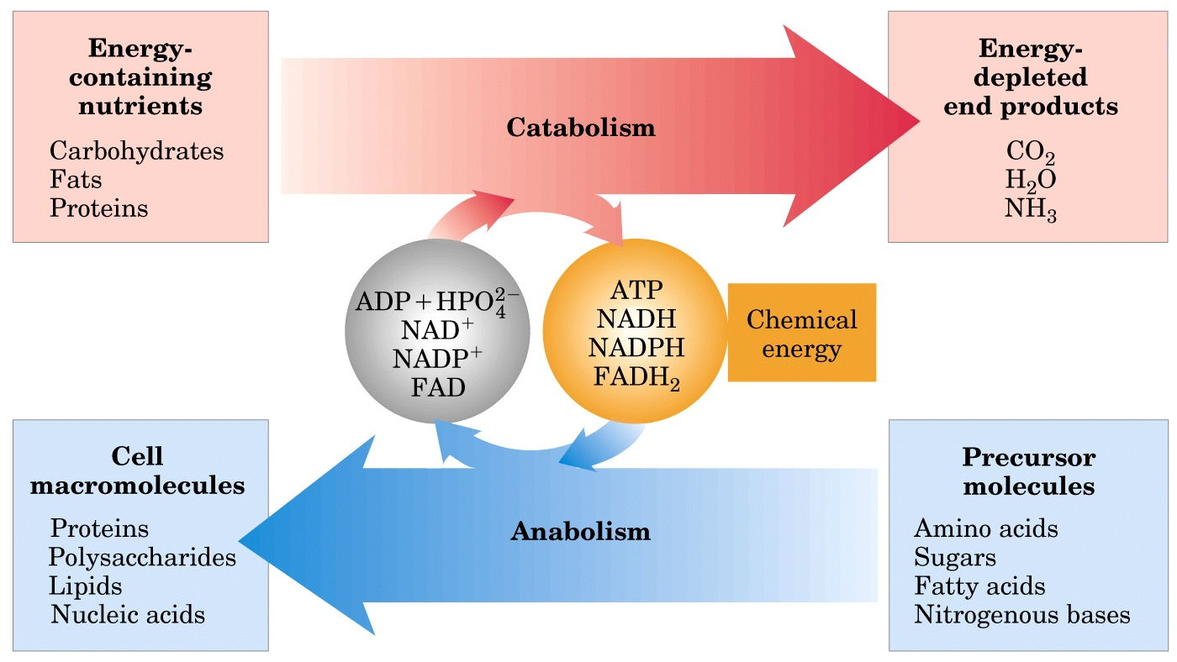
Energy relationships between catabolic and anabolic pathways

Slide 4
Functions of metabolism
Obtain chemical energy from sunlight or nutrients
Convert nutrient molecules into the cell’s own characteristic molecules
Polymerize monomeric precursors into macromolecules
Synthesize and degrade biomolecules required for specialized cellular functions

Slide 5
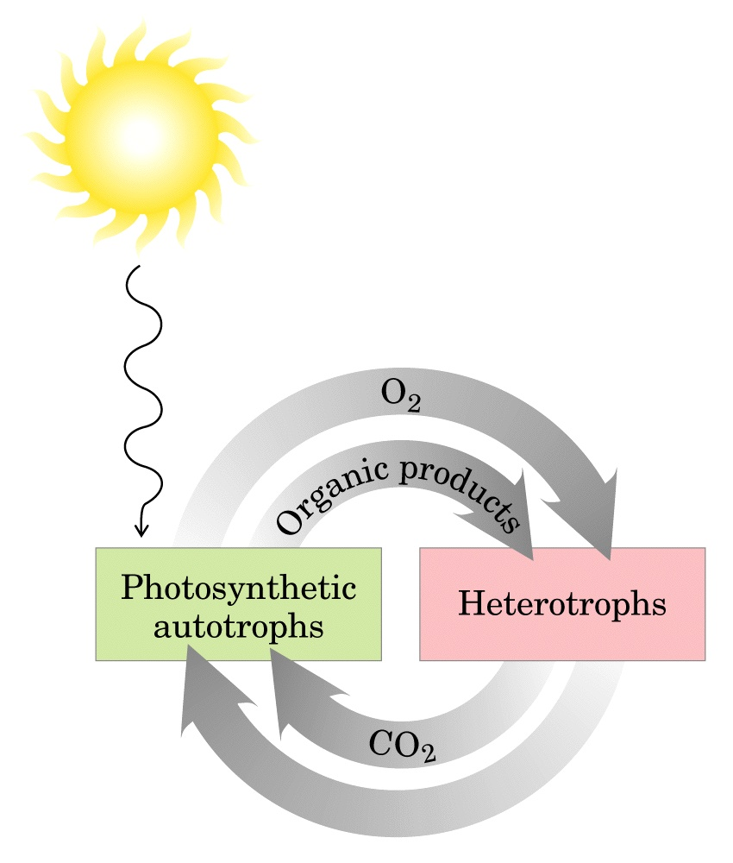
Producers
Consumers
Cycling of CO₂ and O₂ in the biosphere

Slide 6
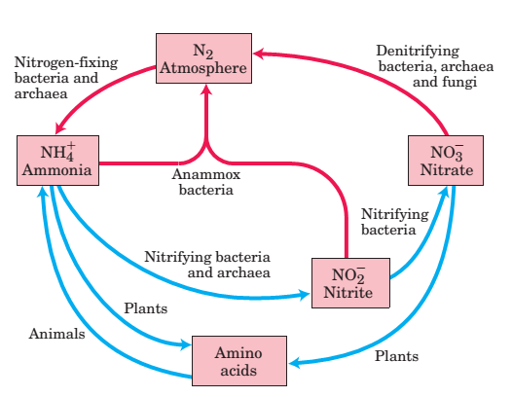
Cycling of nitrogen in the biosphere

Slide 7
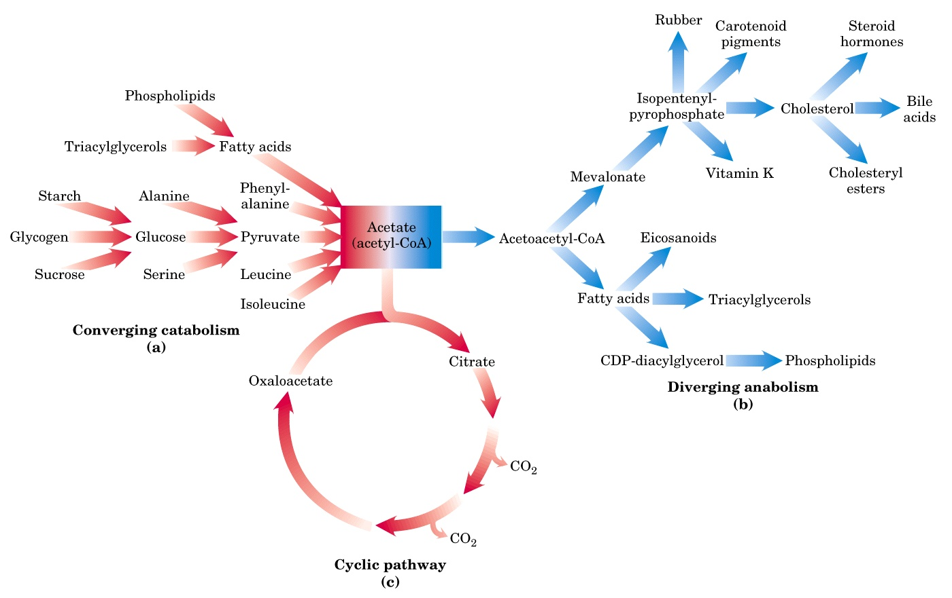
Three types of nonlinear metabolic pathways

Slide 8
History of research on metabolism
Golden time: 1920s-1960s
Many important discoveries: glycolysis, citric acid cycle, oxidative phosphorylation, glycogen metabolism, and ATP in energy transfer reactions
15 Nobel Prizes
Relationship between metabolism and diseases
Revived in the past 10 years
New approach --- metabolomics (代谢组学)

Slide 9
Course outline
Principles of bioenergetics (Ch13)
Major catabolic pathways (Ch14-18)
Oxidative phosphorylation and photophosphorylation (Ch19)
Major anabolic pathways (Ch20-22)
Integration and hormonal regulation of metabolism (Ch23)

Slide 10
Something you should know for Part II
Major catabolic and anabolic pathways, including:
the mechanisms of important reactions
the enzymes or coenzymes involved
regulation of the pathways
interconnection with the other pathways

